Slide 1
Rural, Suburban, Urban

Slide 2
Scenario
Goal: Use Individual Property and Assortivity to model the STI epidemic spreading from a Rural area to an Urban area.
50% of Rural population infected at outbreak.
Rural
1,750
Suburban
5,250
Total Population = 17,500
Urban
10,500
“Initial_Distribution”
For every one person in Rural area there are 3 in the Suburban and 6 in the Urban.
Rural | Suburban | Urban
0.1 | 0.3 | 0.6

Slide 3
Weighting Matrices
[ 0.6, 0.3, 0.1 ]
[ 0.9, 0.09, 0.01 ]
 | Rural | Suburban | Urban
Rural | 0.6 | 0.3 | 0.1
Suburban | 0.3 | 0.6 | 0.3
Urban | 0.1 | 0.3 | 0.6
 | Rural | Suburban | Urban
Rural | 0.90 | 0.09 | 0.01
Suburban | 0.09 | 0.90 | 0.09
Urban | 0.01 | 0.09 | 0.90
[ 0.7, 0.2, 0.1 ]
[ 0.9, 0.1, 0.0 ]
 | Rural | Suburban | Urban
Rural | 0.7 | 0.2 | 0.1
Suburban | 0.2 | 0.7 | 0.2
Urban | 0.1 | 0.2 | 0.7
 | Rural | Suburban | Urban
Rural | 0.9 | 0.1 | 0.0
Suburban | 0.1 | 0.9 | 0.1
Urban | 0.0 | 0.1 | 0.9
[ 0.8, 0.15, 0.05 ]
[ 1.0, 0.0, 0.00 ]
 | Rural | Suburban | Urban
Rural | 0.80 | 0.15 | 0.05
Suburban | 0.15 | 0.80 | 0.15
Urban | 0.05 | 0.15 | 0.80
 | Rural | Suburban | Urban
Rural | 1.0 | 0.0 | 0.0
Suburban | 0.0 | 1.0 | 0.0
Urban | 0.0 | 0.0 | 1.0

Slide 4
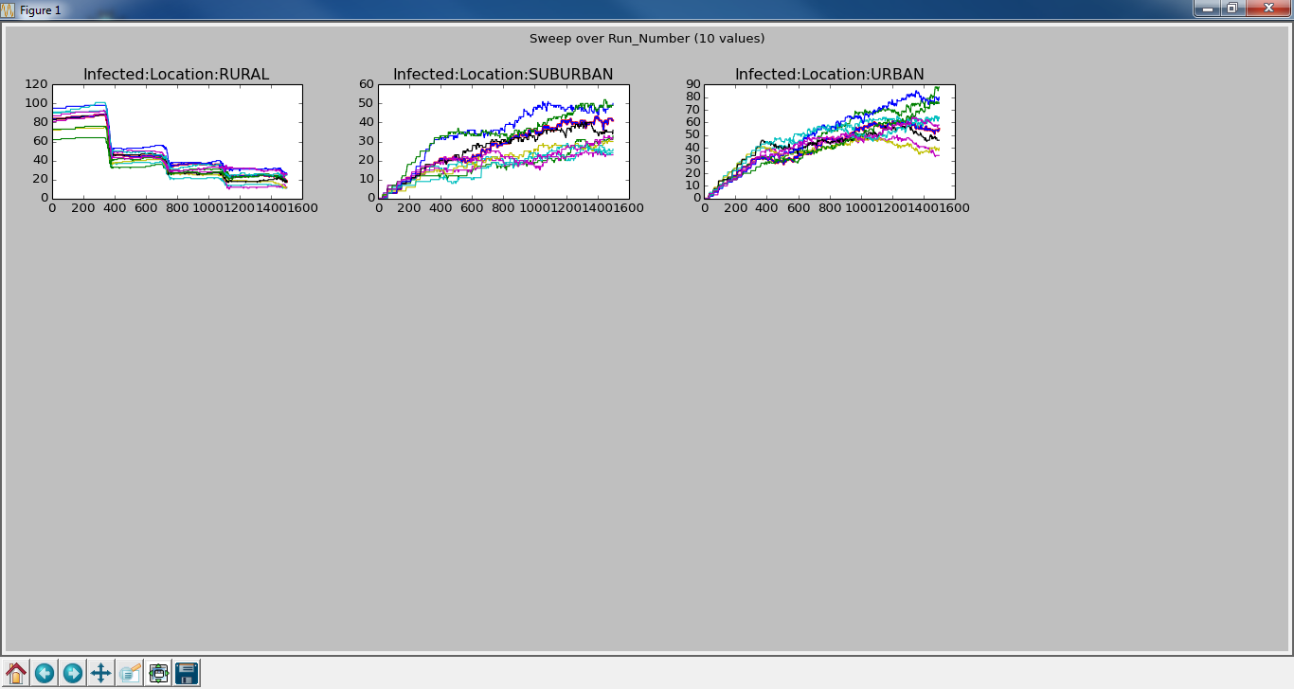
Sweep – NO_GROUP
Infection starts out in Rural area and drops as each 365 day infection period ends. We also see the infection in the other areas grow immediately.

Slide 5
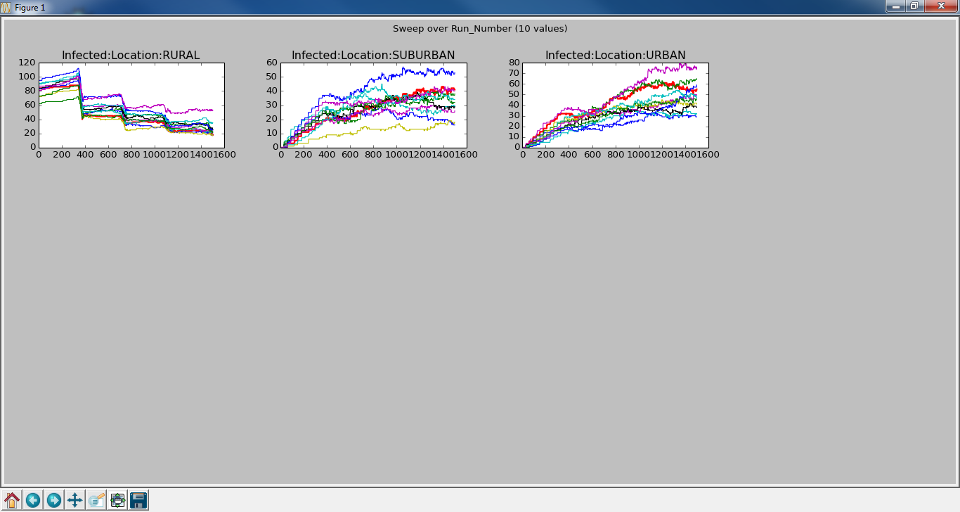
Sweep – [ 0.6, 0.3, 0.1 ]
Now that we limit the number of relationships in the other areas, we see the amount of infection in the Rural area growing and the others declining.

Slide 6
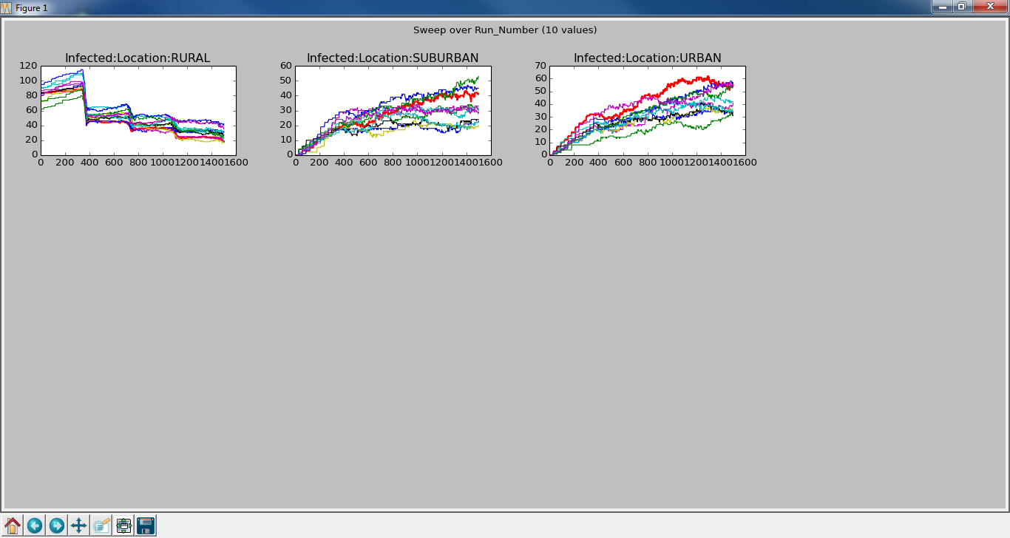
Sweep – [0.7, 0.2, 0.1 ]
As we increase the tendency towards relationships in the same area, we see the infection decrease in the non-infected areas, especially Urban. More infection needs to come through Suburban.

Slide 7
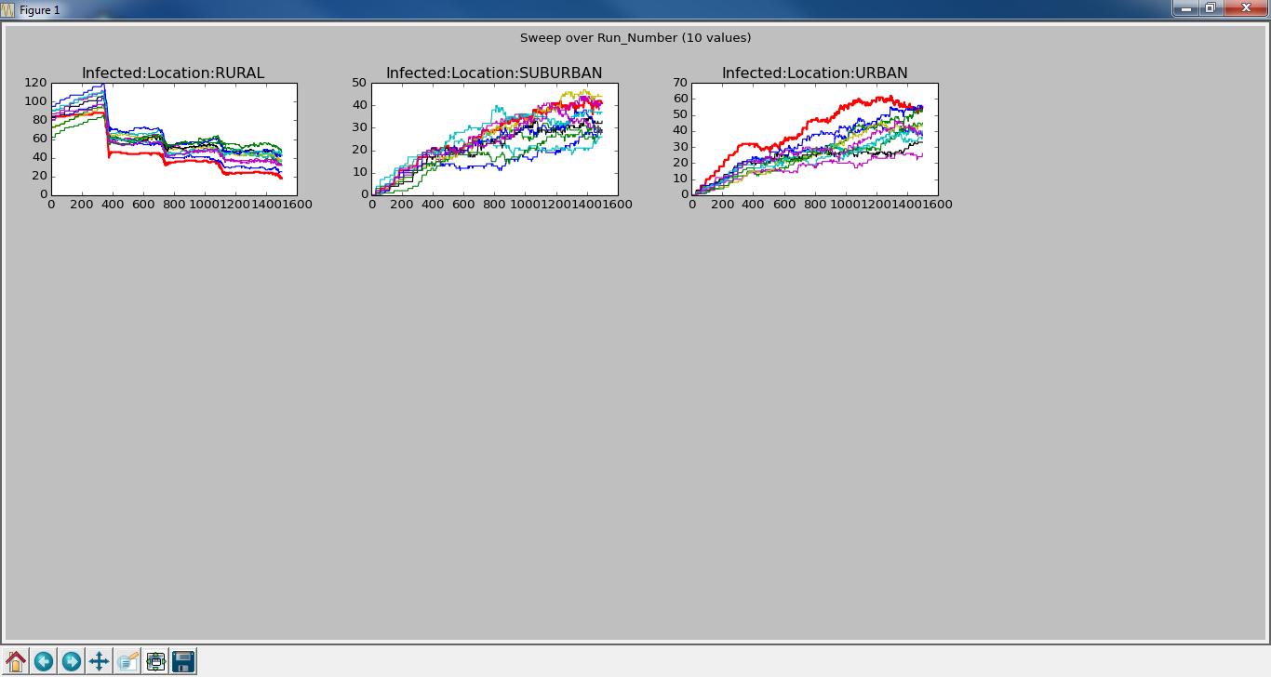
Sweep – [ 0.8, 0.15, 0.05 ]
Again, as we increase the tendency towards relationships in the same area, we continue to see the amount of infection in Rural rise and Urban fall.

Slide 8
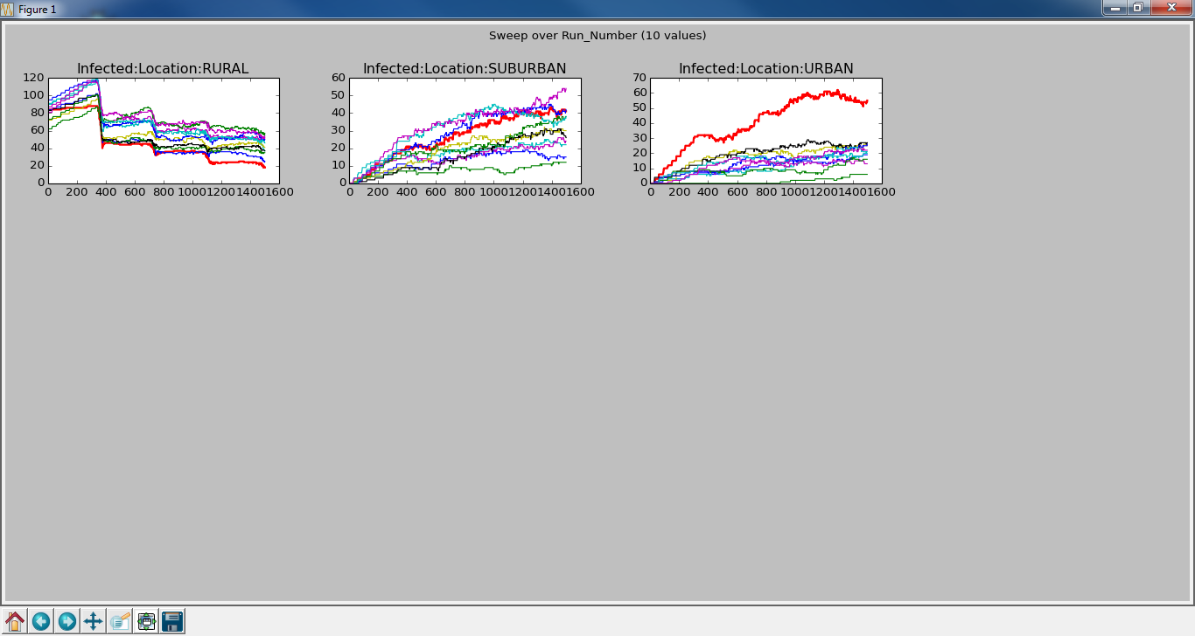
Sweep – [0.9, 0.09, 0.01 ]
The trend continues.

Slide 9
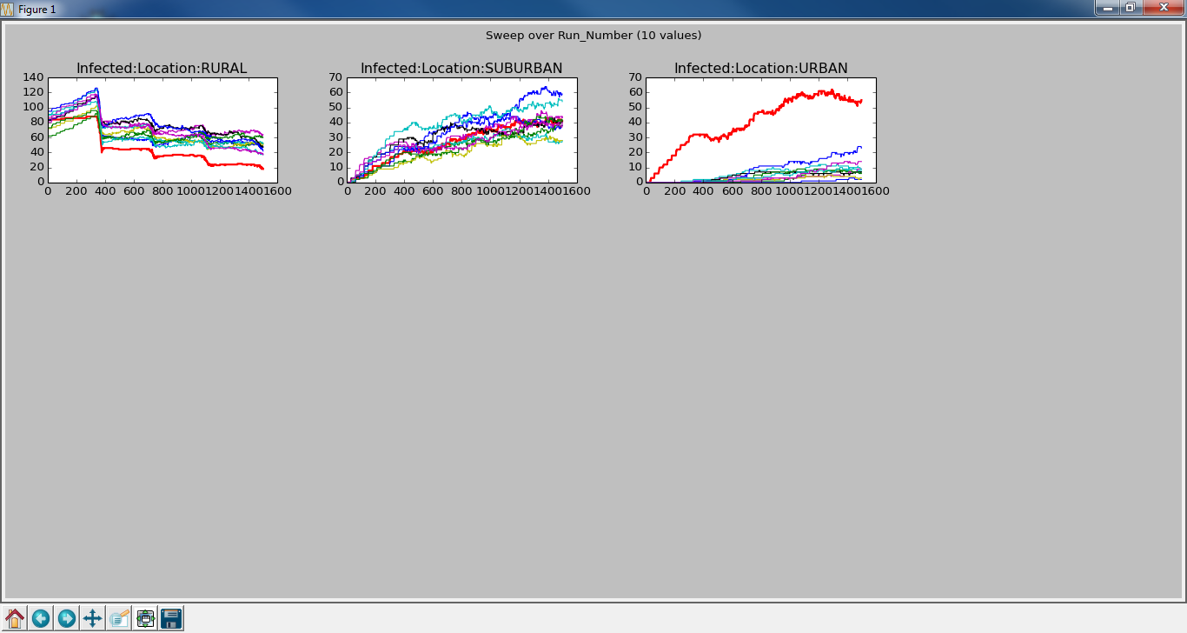
Sweep – [ 0.9, 0.1, 0.0 ]
Finally, not allowing relationships to start between Rural and Urban people, we can see a delay before people start getting infected in the Urban area.

Slide 10
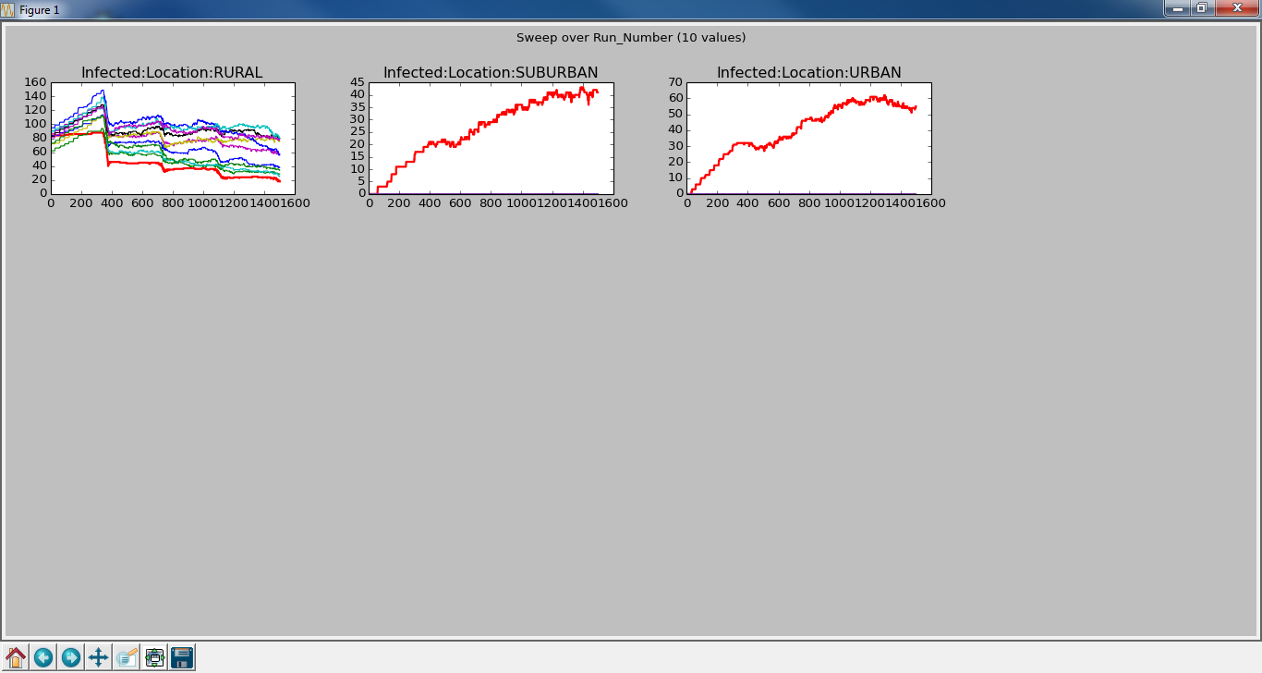
Sweep – [ 1.0, 0.0, 0.0 ]
As expected, infection was not allowed to spread outside of Rural area.

Slide 11
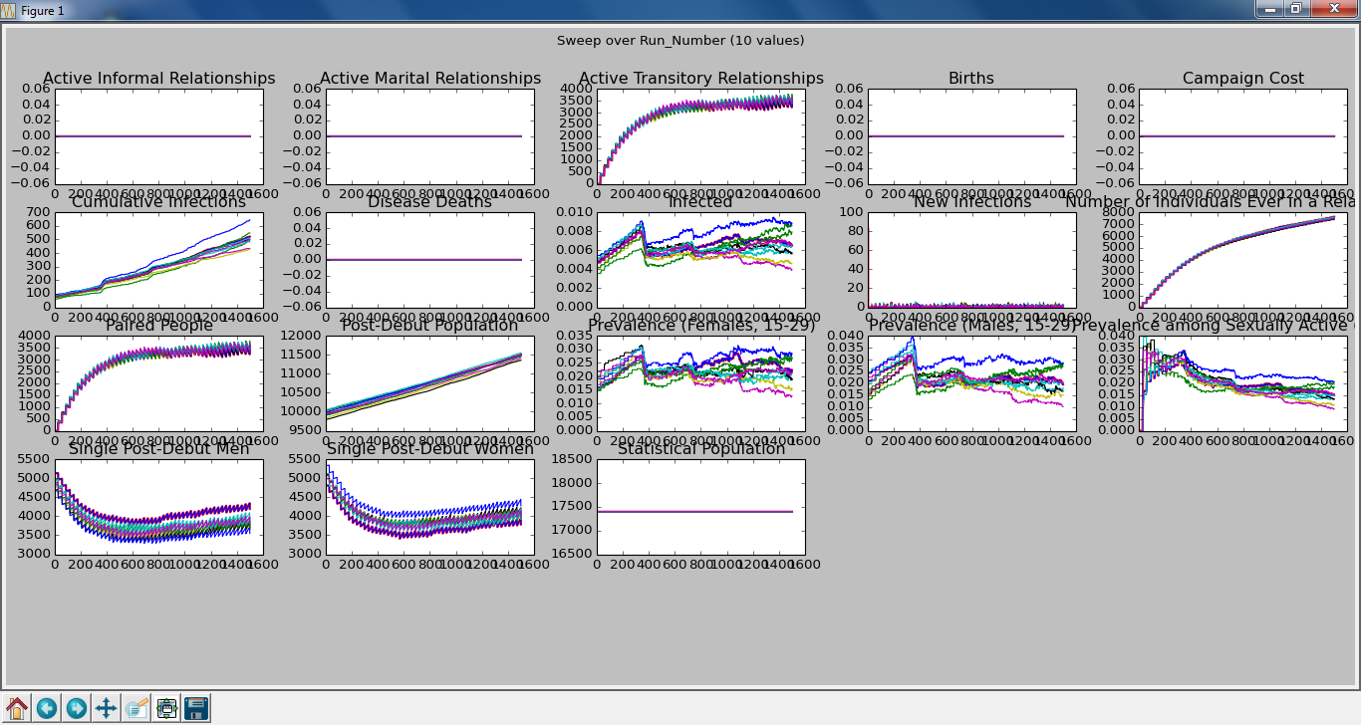
Sweep – NO_GROUP

Slide 12
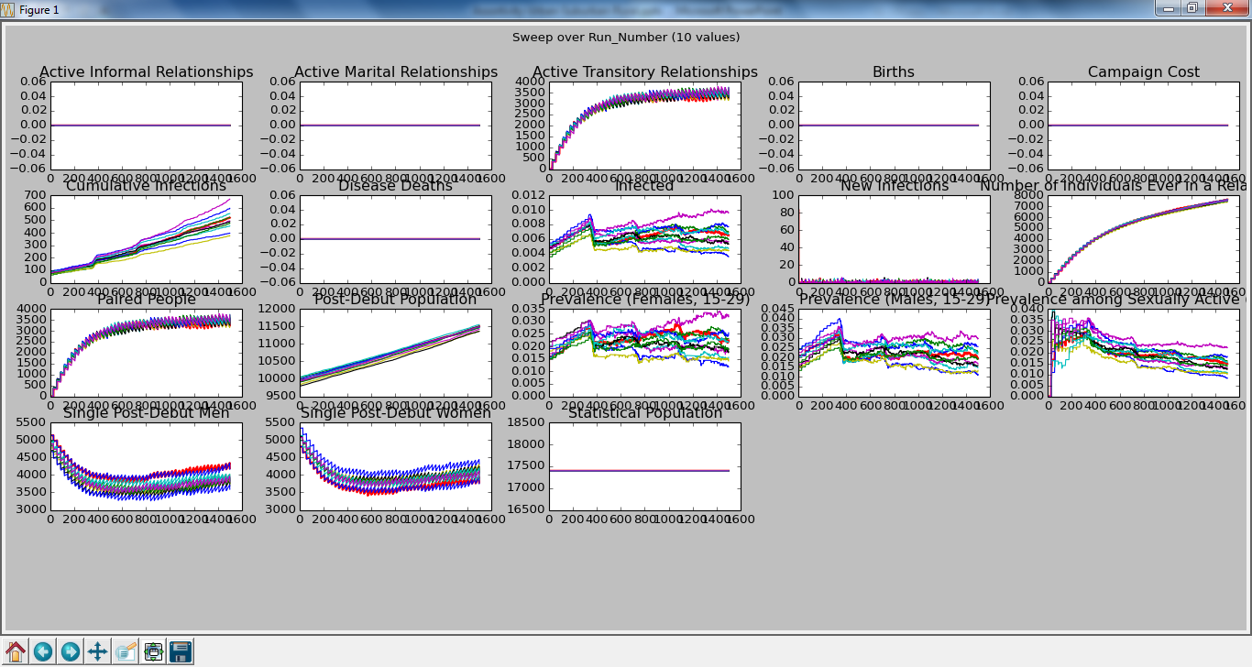
Sweep – [ 0.6, 0.3, 0.1 ]
We decreased the amount of cross area relationship forming, but it is hard to see much difference

Slide 13
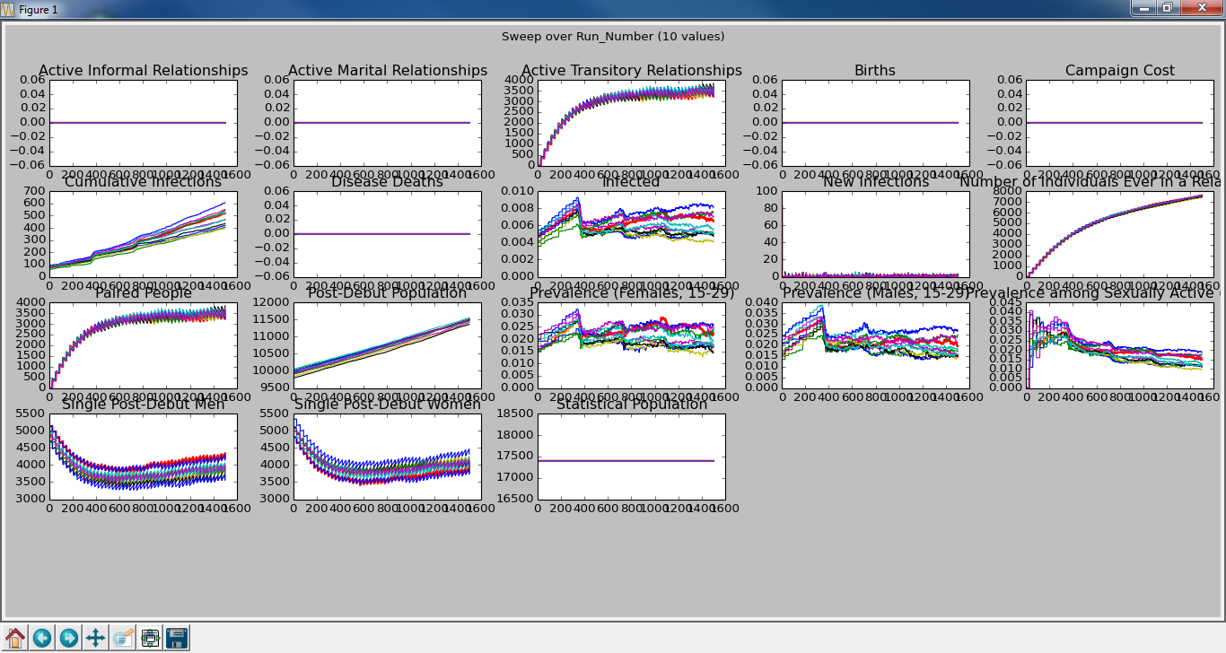
Sweep – [0.7, 0.2, 0.1 ]
We increased the amount of like area relationship forming. Maybe we see a decrease in prevalence?

Slide 14
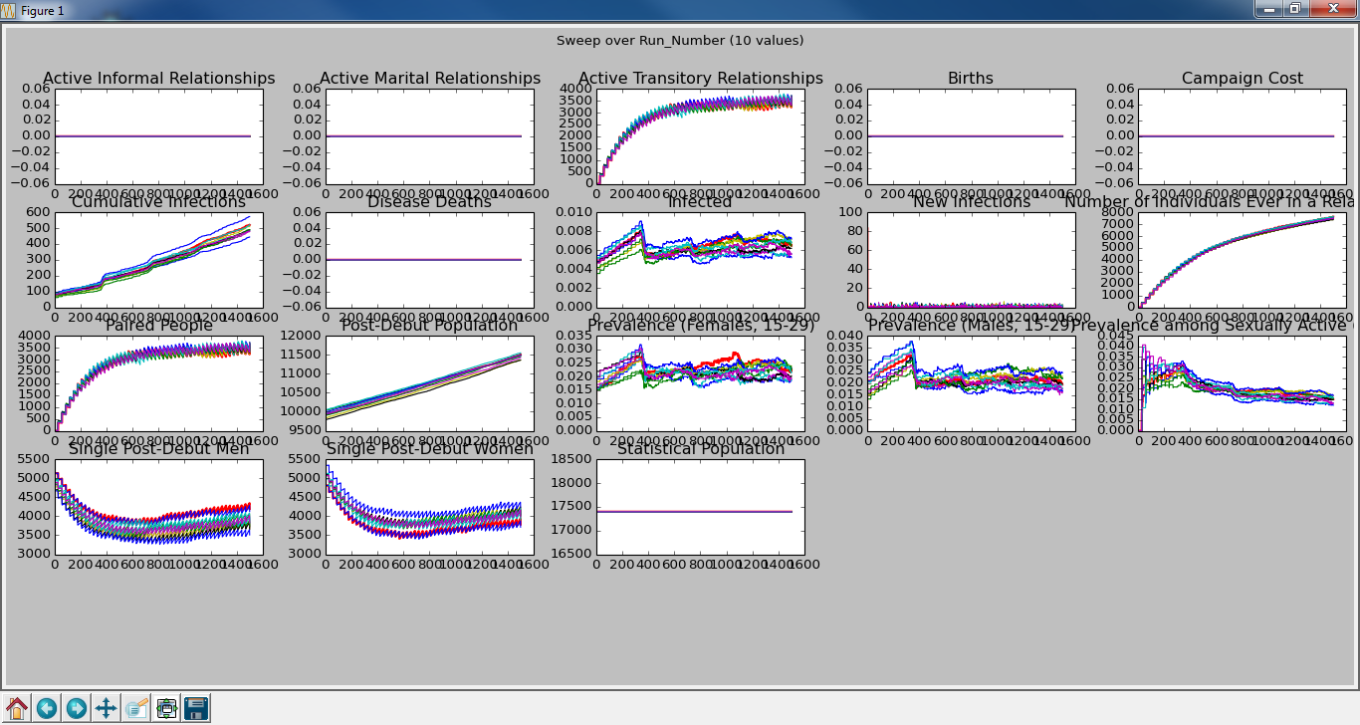
Sweep – [ 0.8, 0.15, 0.05 ]
Continuing to increase like area relationships. Still don’t see a big change.

Slide 15
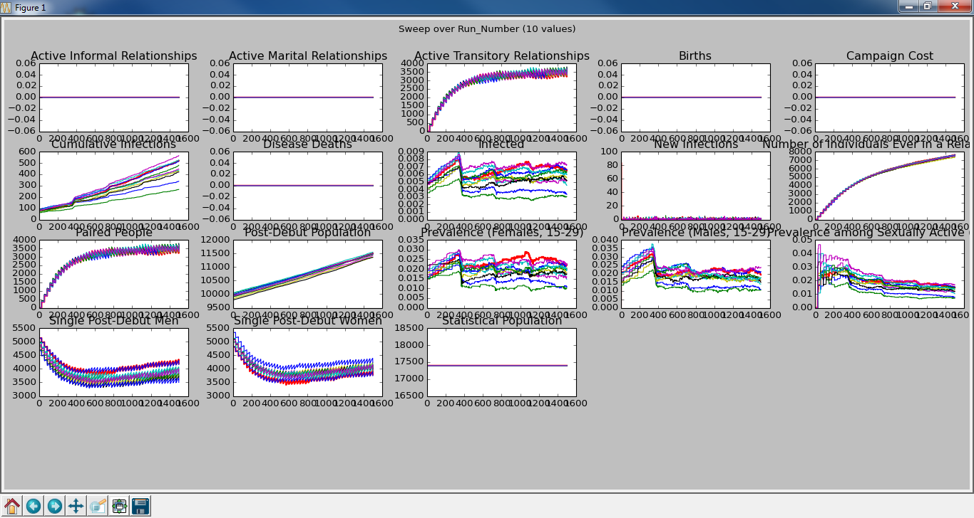
Sweep – [0.9, 0.09, 0.01 ]
Finally, we see prevalence to really start to fall the more we make it unlikely that a relationship forms with out of area people.

Slide 16
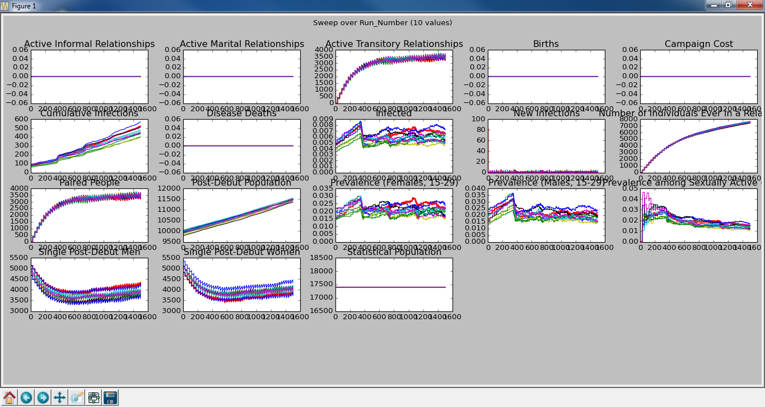
Sweep – [ 0.9, 0.1, 0.0 ]
Hmm. Percentage wise, we don’t see that it is harder to get people infected in the Urban area.

Slide 17
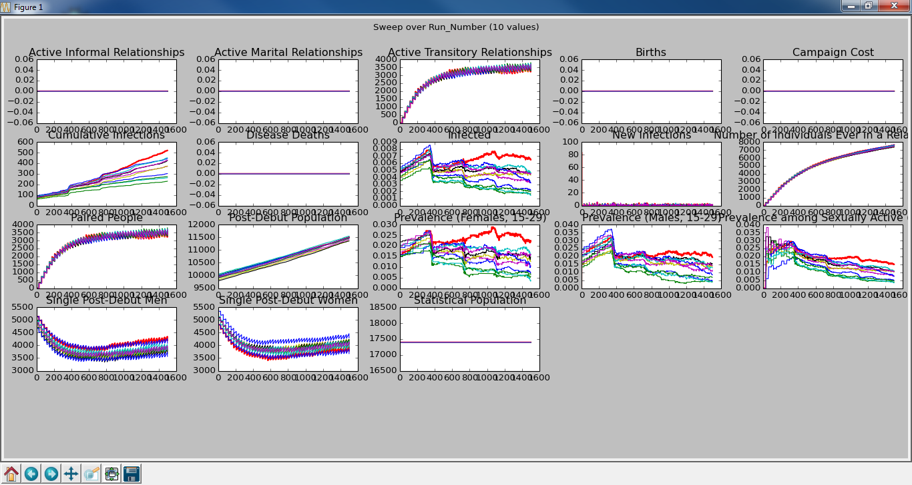
Sweep – [ 1.0, 0.0, 0.0 ]
If we finally don’t allow relationships with people in other areas, then as expected, we see a decrease in prevalence.

Slide 18
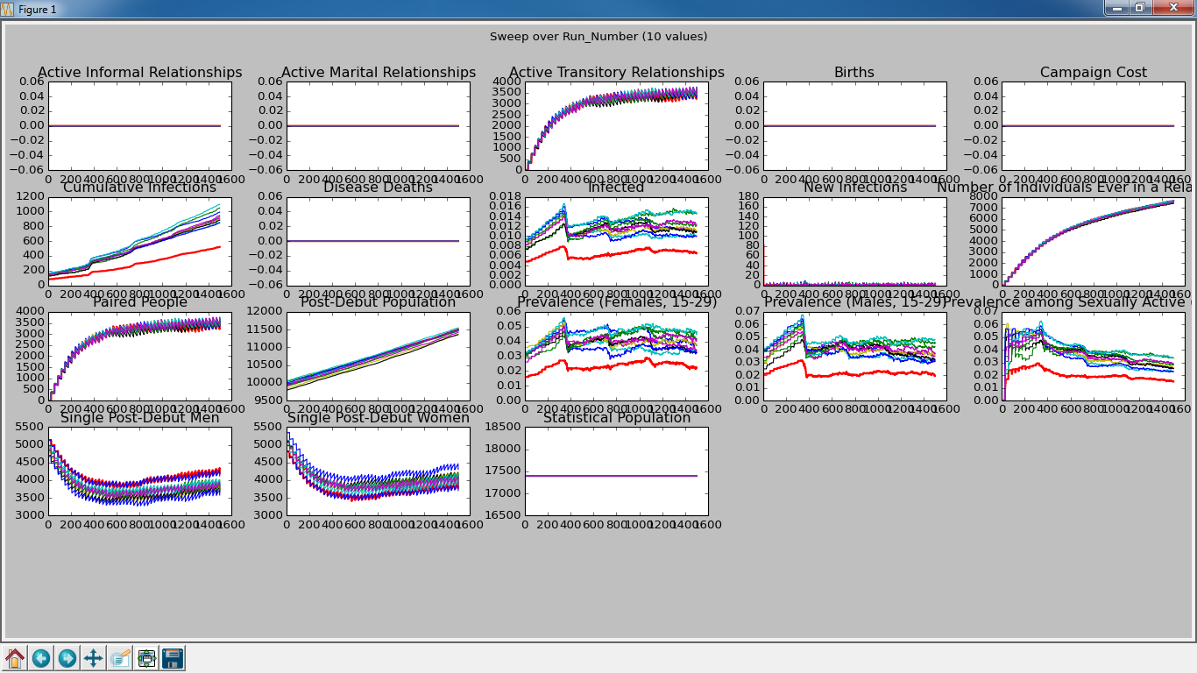
Increase Outbreak to 90% Red is 50% Outbreak
If we increase the size of the outbreak, then we will reduce the number of infections that can be spread in the Rural area. New infections should come from other areas.

Slide 19

Sweep – NO_GROUP 90% Outbreak

Slide 20
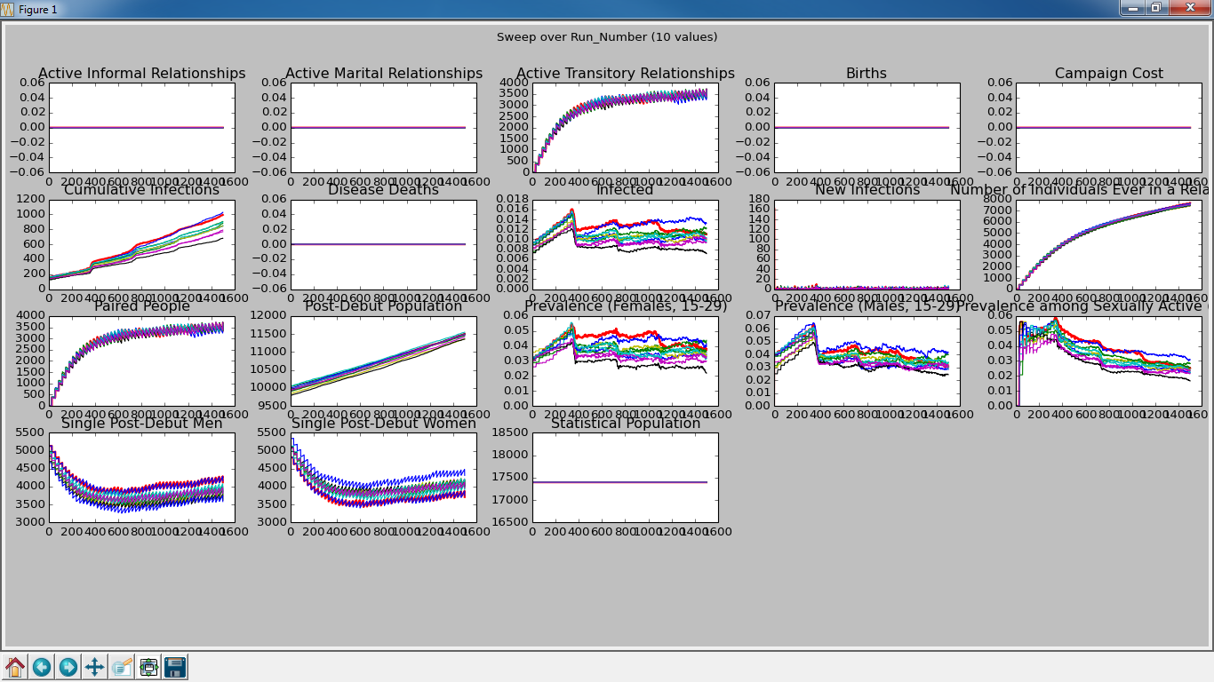
Sweep – [ 0.5, 0.3, 0.2 ] 90% Outbreak
NEW MATRIX: As we lean towards relationships in the same area, we see prevalence drop.

Slide 21
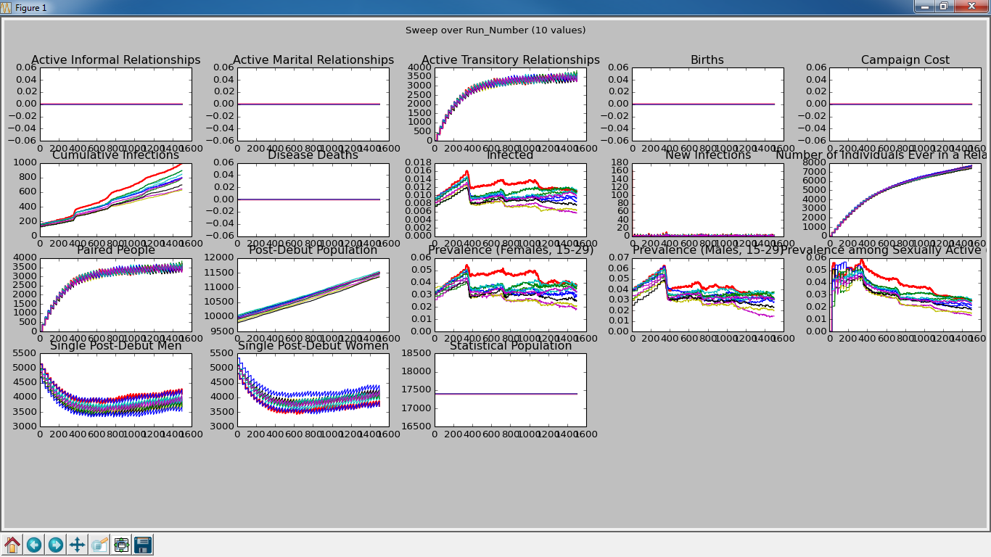
Sweep – [ 0.6, 0.3, 0.1 ] 90% Outbreak
As we increase the tendency towards same area relationships, we see more decrease in prevalence.

Slide 22
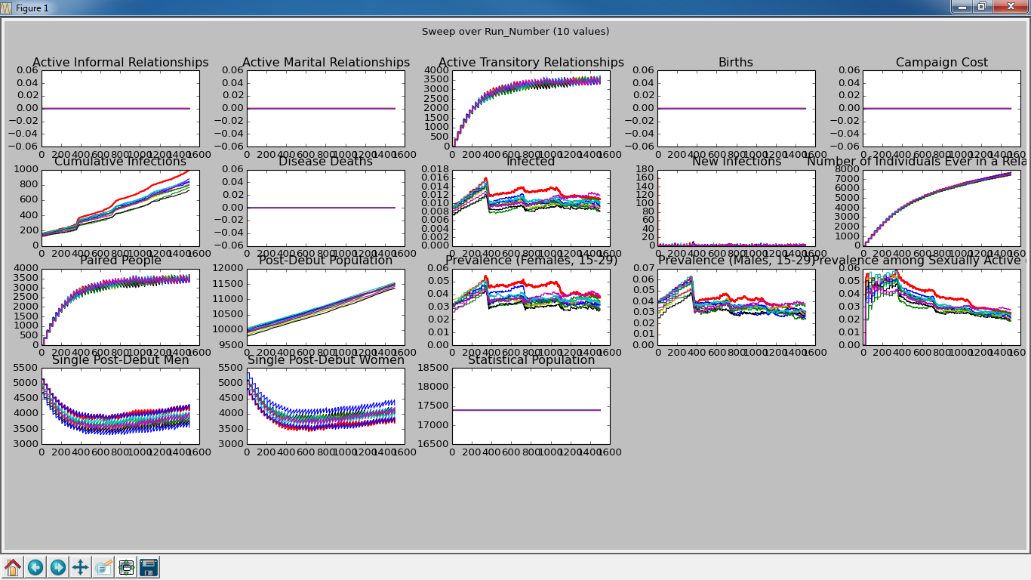
Sweep – [0.7, 0.2, 0.1 ] 90% Outbreak
Hmm. Increasing tendency towards same area relationships does not continue to decrease prevalence. Hmm.

Slide 23
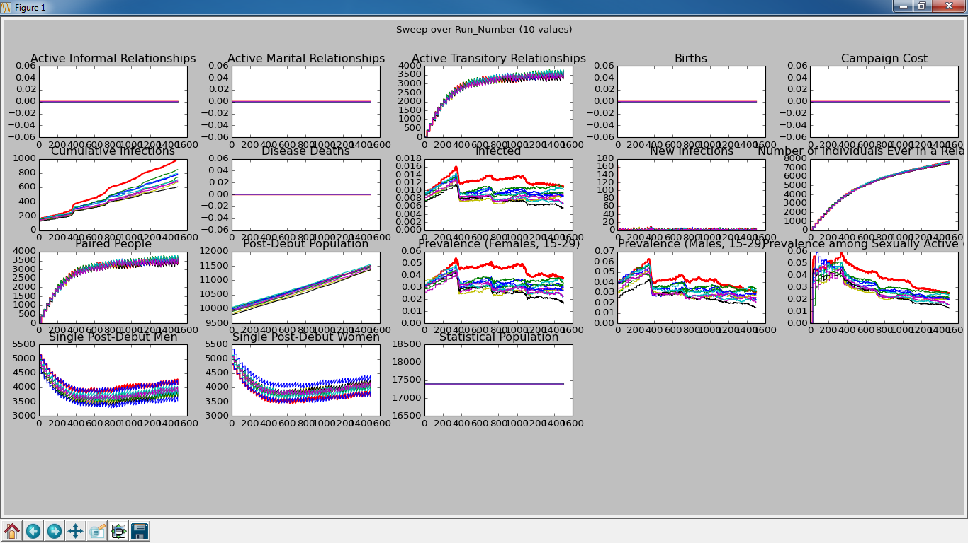
Sweep – [ 0.8, 0.15, 0.05 ] 90% Outbreak
Hmm. This is really not much different that [ 0.6, 0.3, 0.1 ].

Slide 24
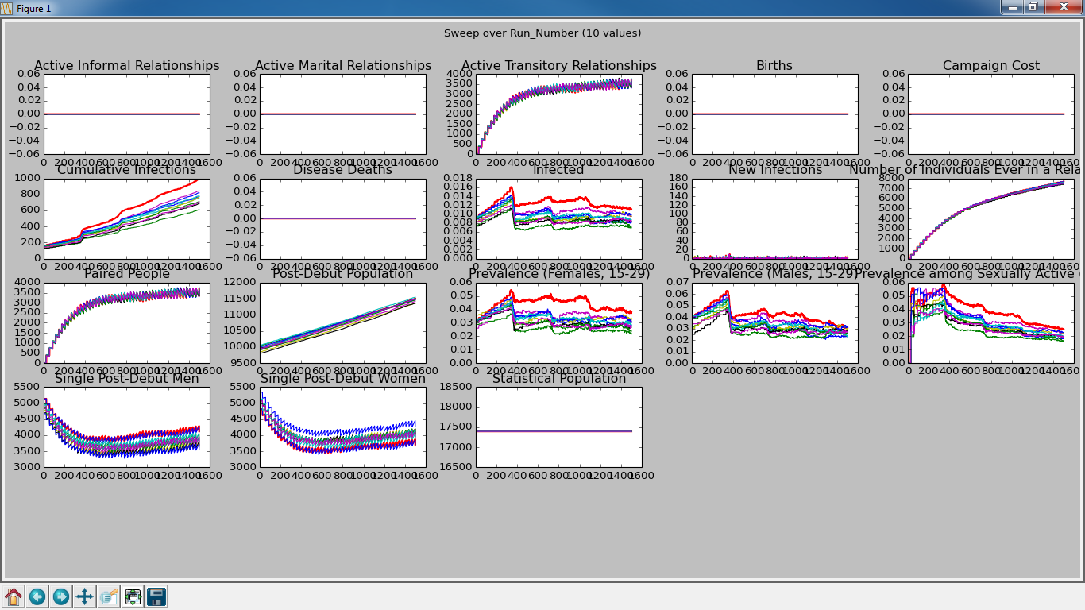
Sweep – [0.9, 0.09, 0.01 ] 90% Outbreak
Hmm. Still not much difference.

Slide 25
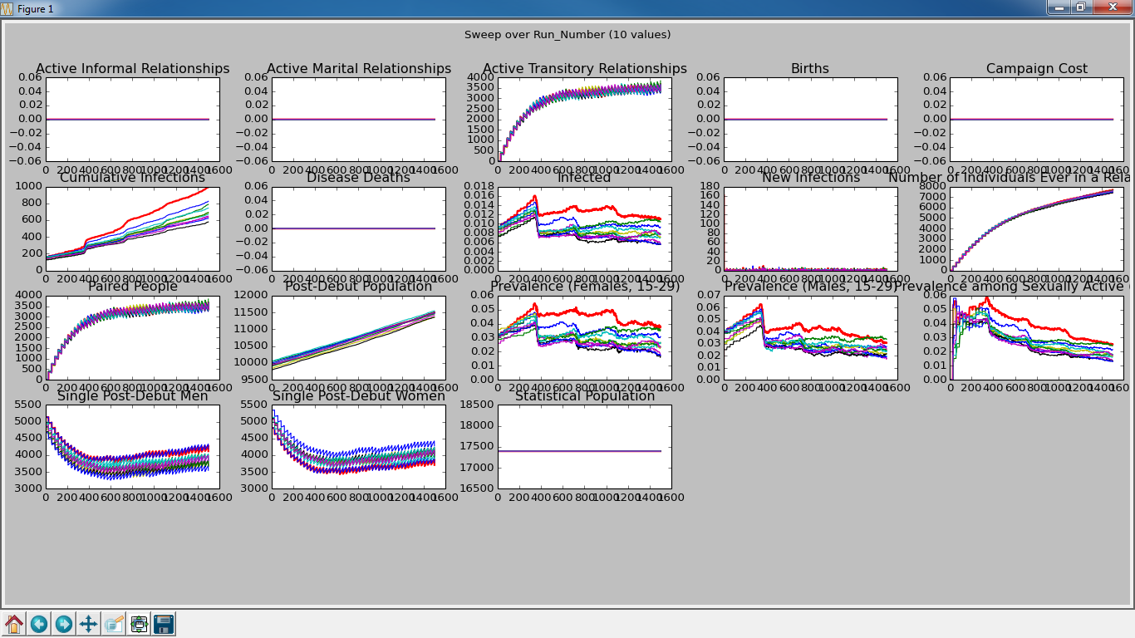
Sweep – [ 0.9, 0.1, 0.0 ] 90% Outbreak
Even with the zero prevalence doesn’t fall much.

Slide 26
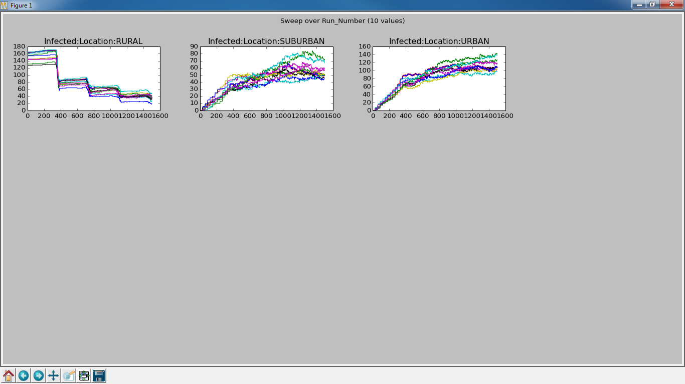
Sweep – NO_GROUP 90% Outbreak

Slide 27
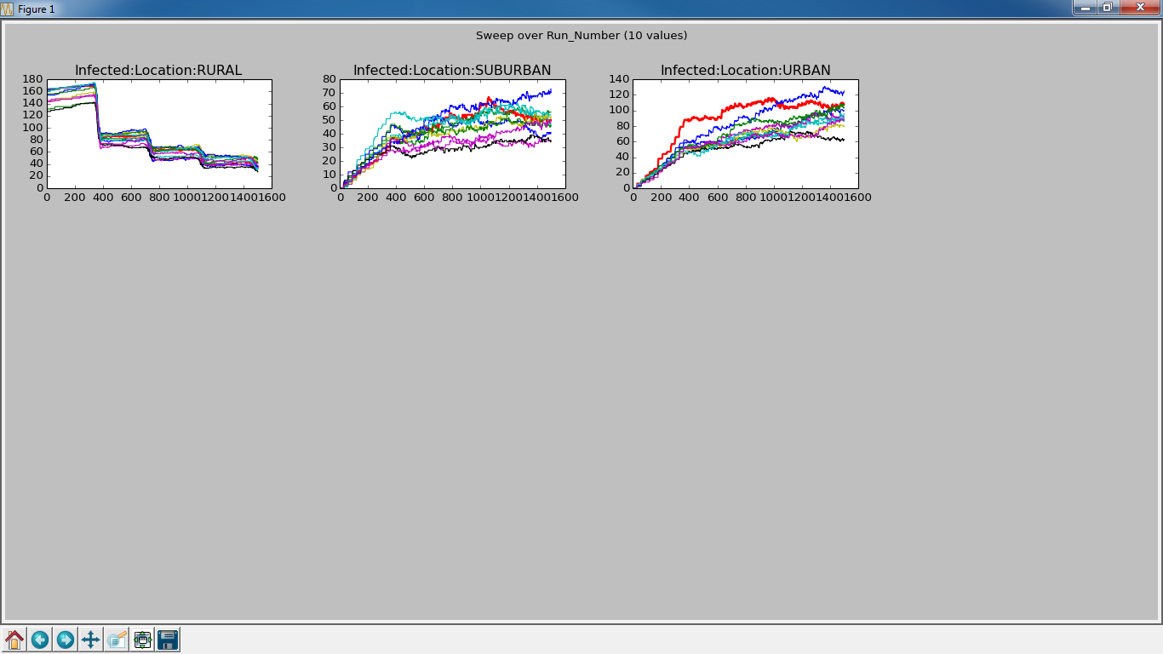
Sweep – [ 0.5, 0.3, 0.2 ] 90% Outbreak
Number of infections in Urban really drops. Much more than in the 50% Outbreak case.

Slide 28
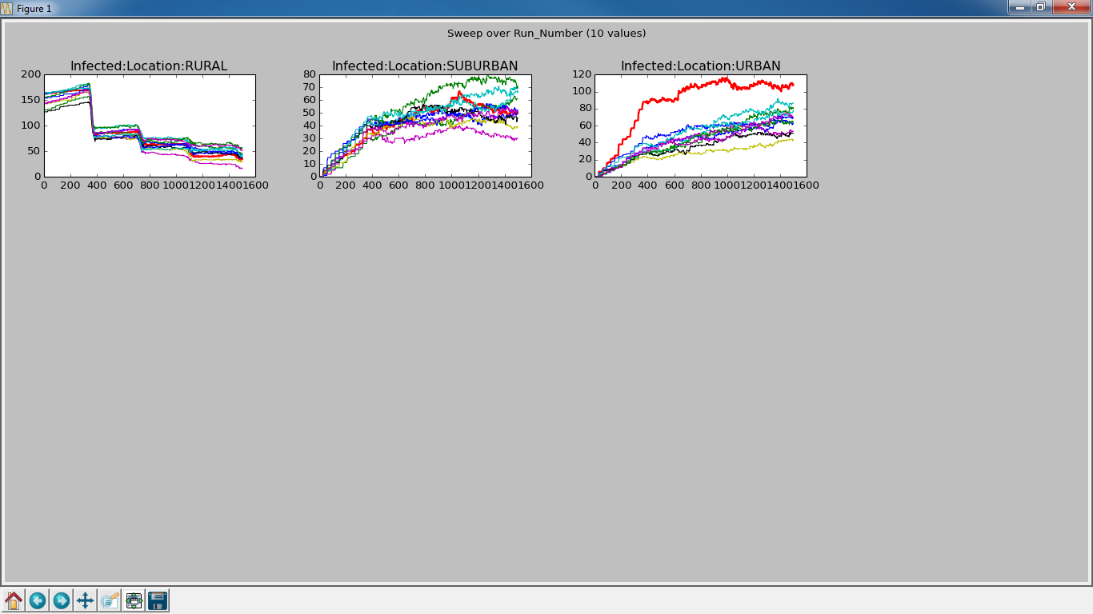
Sweep – [ 0.6, 0.3, 0.1 ] 90% Outbreak
More significant decrease in the Urban area.

Slide 29
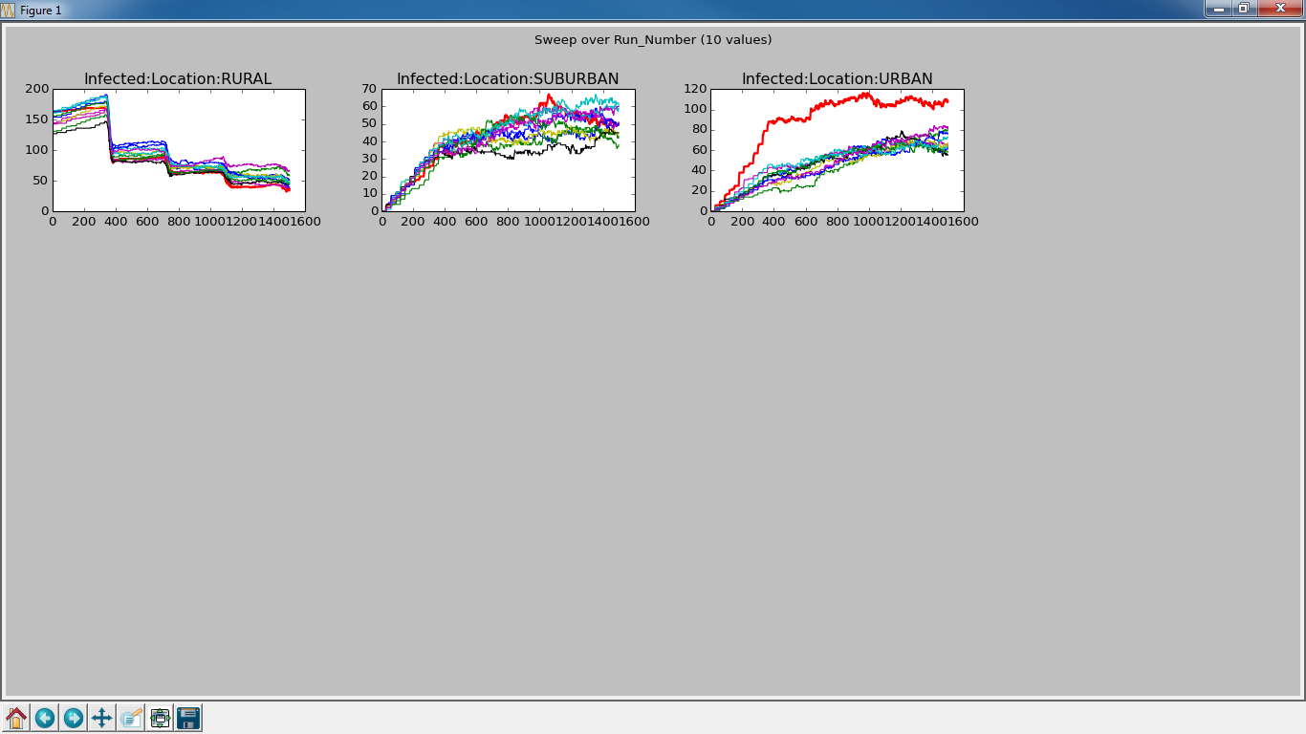
Sweep – [0.7, 0.2, 0.1 ] 90% Outbreak
Not so much change now.

Slide 30
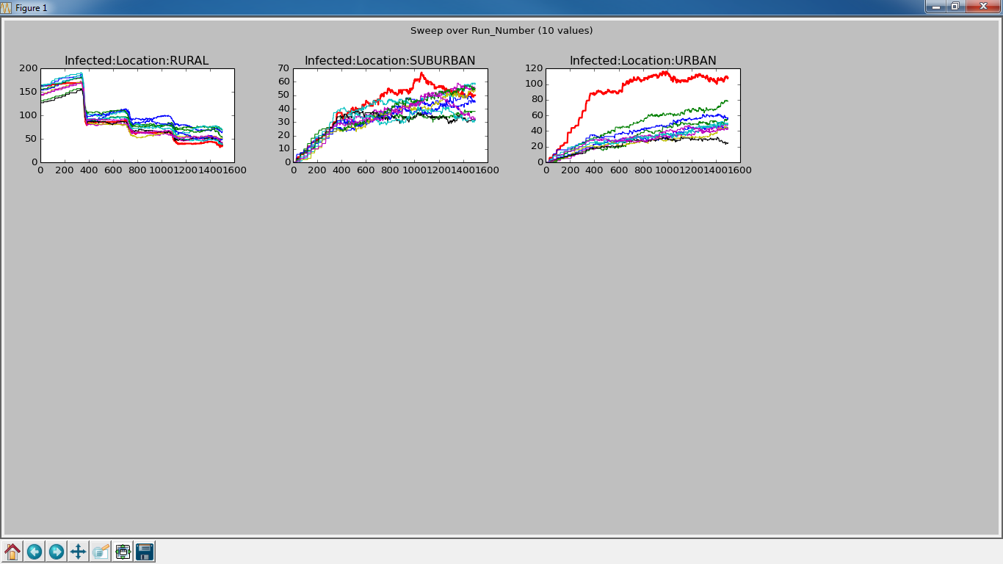
Sweep – [ 0.8, 0.15, 0.05 ] 90% Outbreak
Change not big, but down in the Suburban and Urban areas.

Slide 31
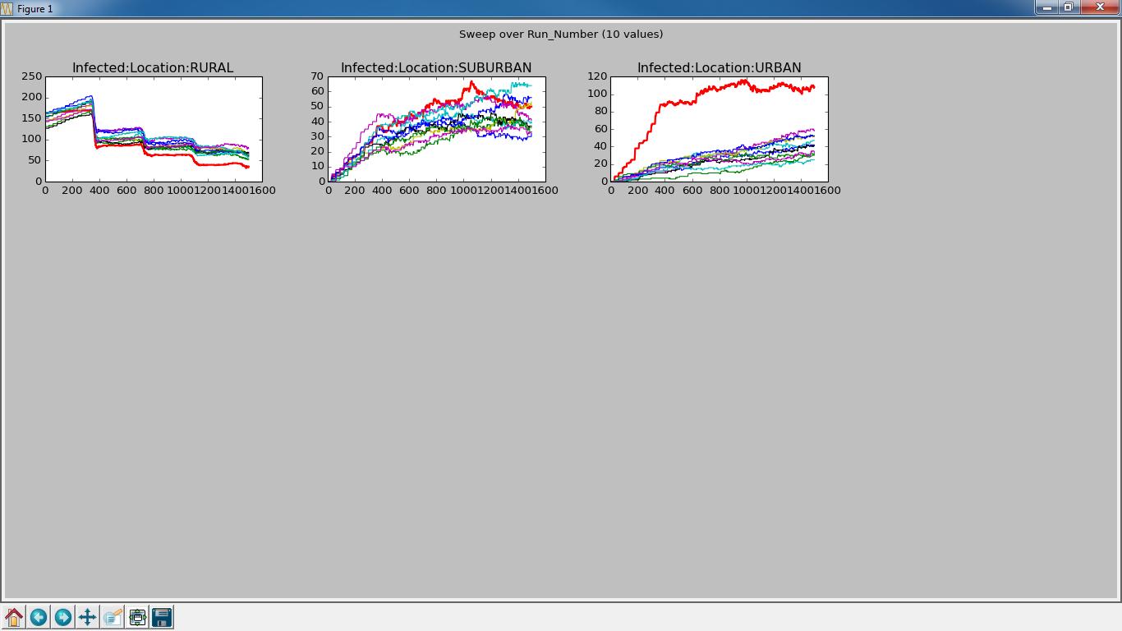
Sweep – [0.9, 0.09, 0.01 ] 90% Outbreak
Just like you like to see, continued decrease in the non-Rural areas.

Slide 32
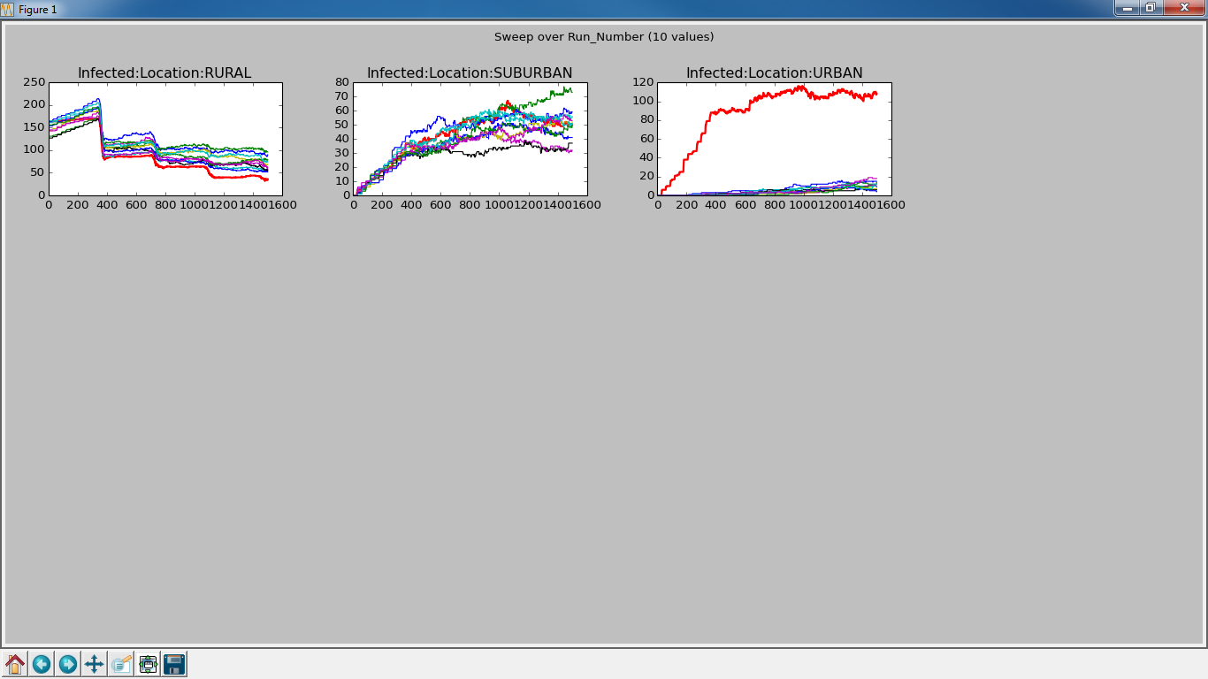
Sweep – [ 0.9, 0.1, 0.0 ] 90% Outbreak
Zero forces infection to go through Suburban and Suburban has more infections/relationships due to relationships not being allowed to form between Rural and Urban.

Slide 33
Backup

Slide 34
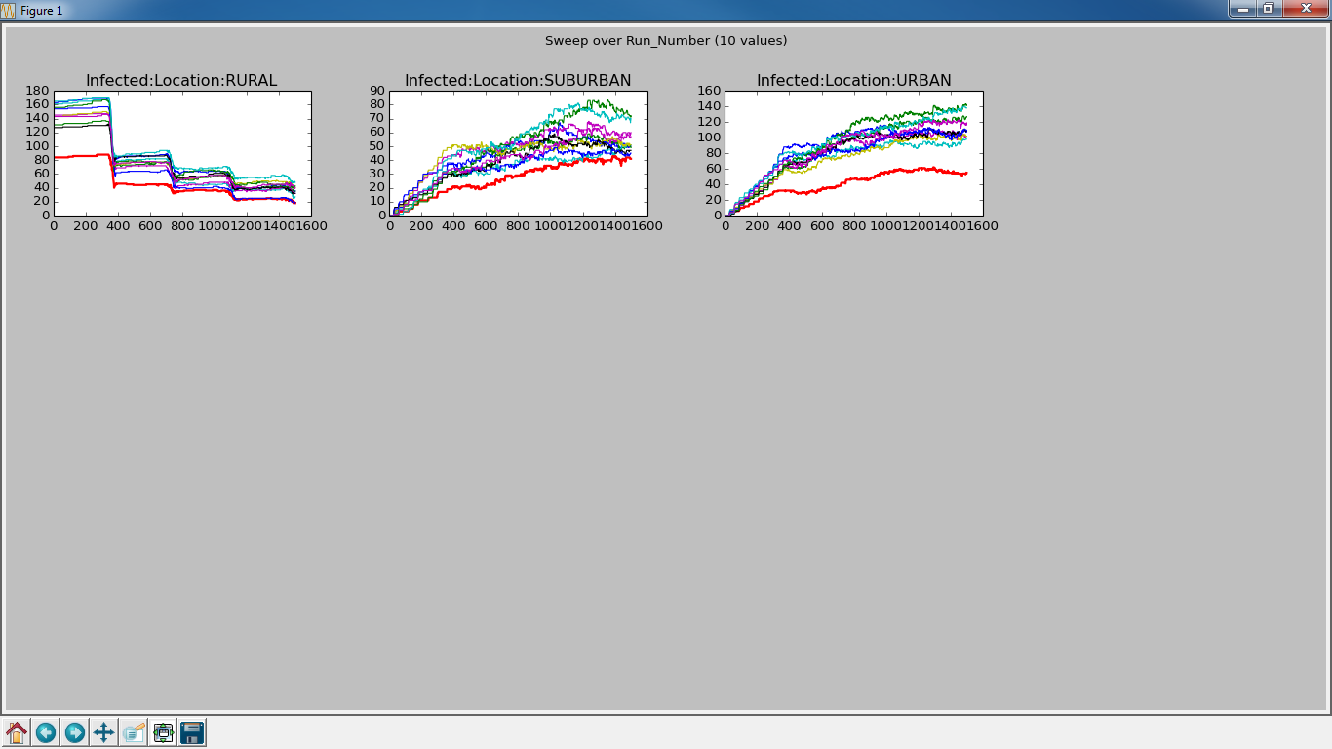
Increase Outbreak to 90% Red is 50% Outbreak

Slide 35
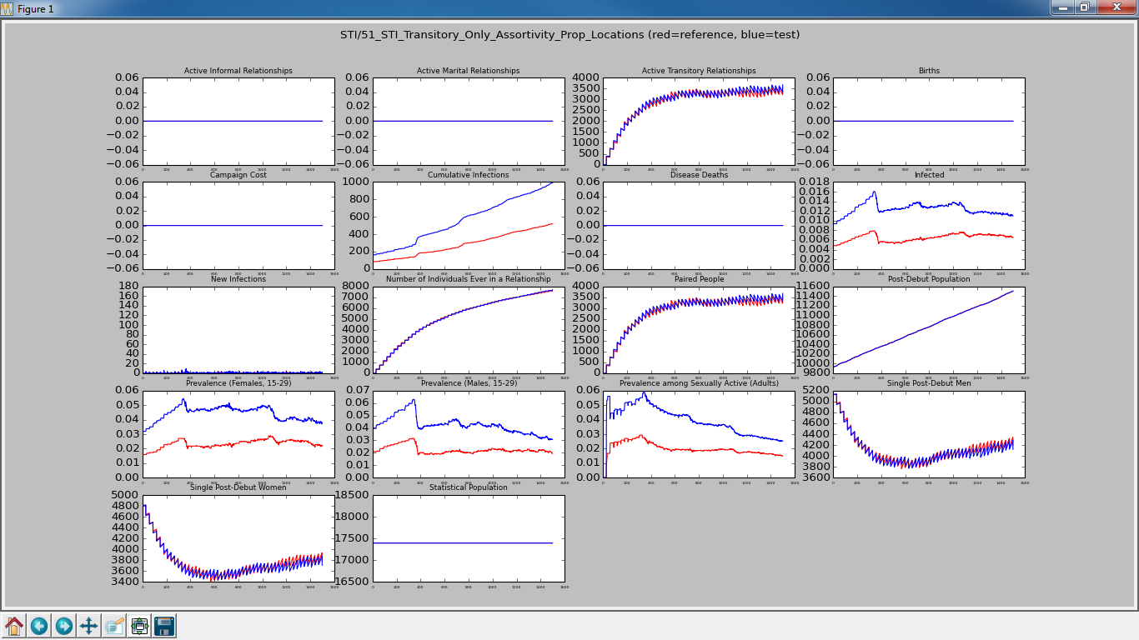
50% vs 90% Outbreak Baselines

Slide 36
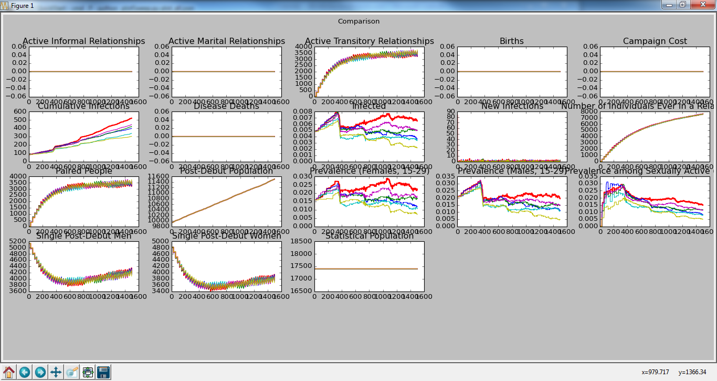
Single Run Summary
NO_GROUP
[ 0.9, 0.1, 0.0 ]
[ 0.7, 0.2, 0.1 ]
[ 0.6, 0.3, 0.1 ]
[ 0.9, 0.09, 0.01 ]
[ 1.0, 0.0, 0.0 ]

Slide 37
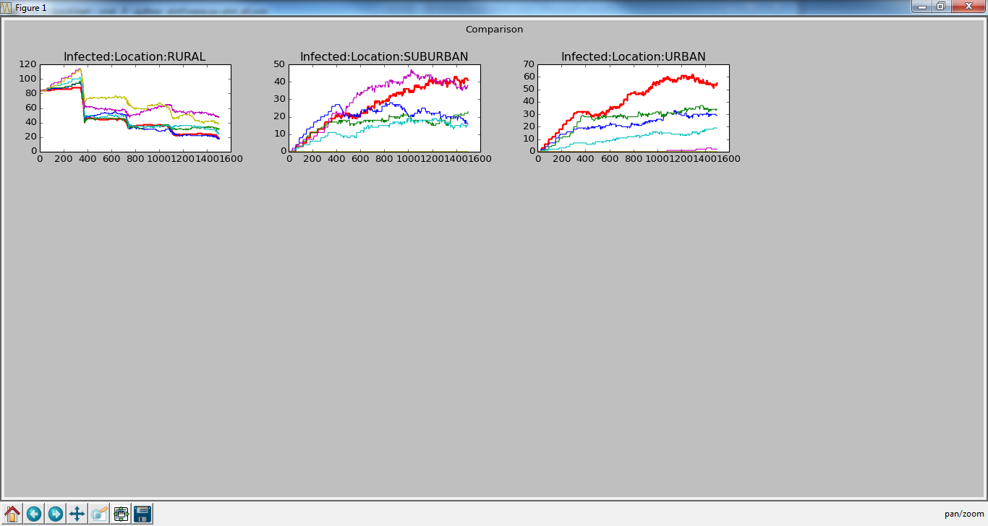
Single Run Summary
NO_GROUP
[ 0.9, 0.1, 0.0 ]
[ 0.7, 0.2, 0.1 ]
[ 0.6, 0.3, 0.1 ]

